Slide 1
Zhao Lab Meeting
Jingxuan Chen, Aug 25, 2023

Slide 2

Bioinformatics and evolutionary genomics of transposable elements in yeast
Jingxuan Chen
Bergman Lab, Institute of Bioinformatics
6/29/2023
Notes:
Scan recombination for pairwise
Discussion on difficulty of method and tree

Slide 3
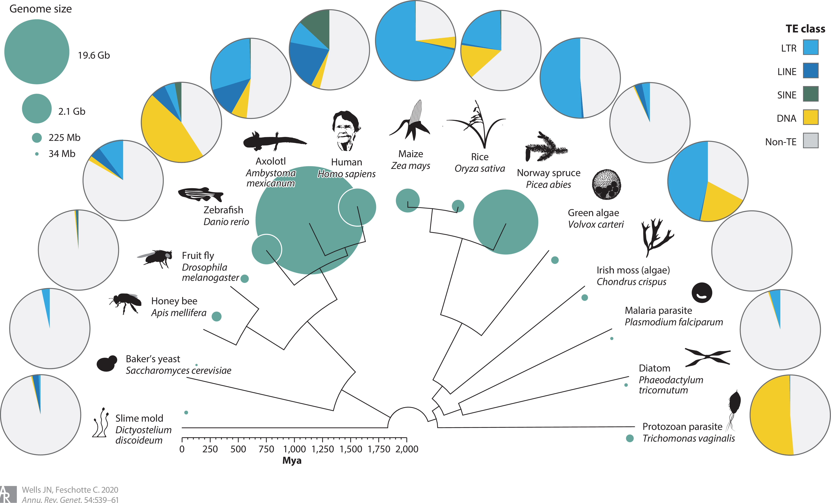
Variant classes and proportions of transposable elements (TE) in eukaryotic genomes
Retrotransposon
Transposon
Wells et al. Annual Review of Genetics 54, 539–561 (2020).
Notes:
Transposable elements (TEs) are repetitive DNA sequences that can mobilize within the host genome.
are found in most eukaryotic genomes and can cause mutations of large effect.
The pie chart shows the content and proportions of TE in different organisms.
The size of the green inner circle indicate the genome size.
Diversity:
different types of transposons
different proportion of genomes. eg. maize, human -> TE are important in genome size evolution
only LTR retrotransposon in yeast, taking part of only <5% of the genome: like retro virus

Slide 4
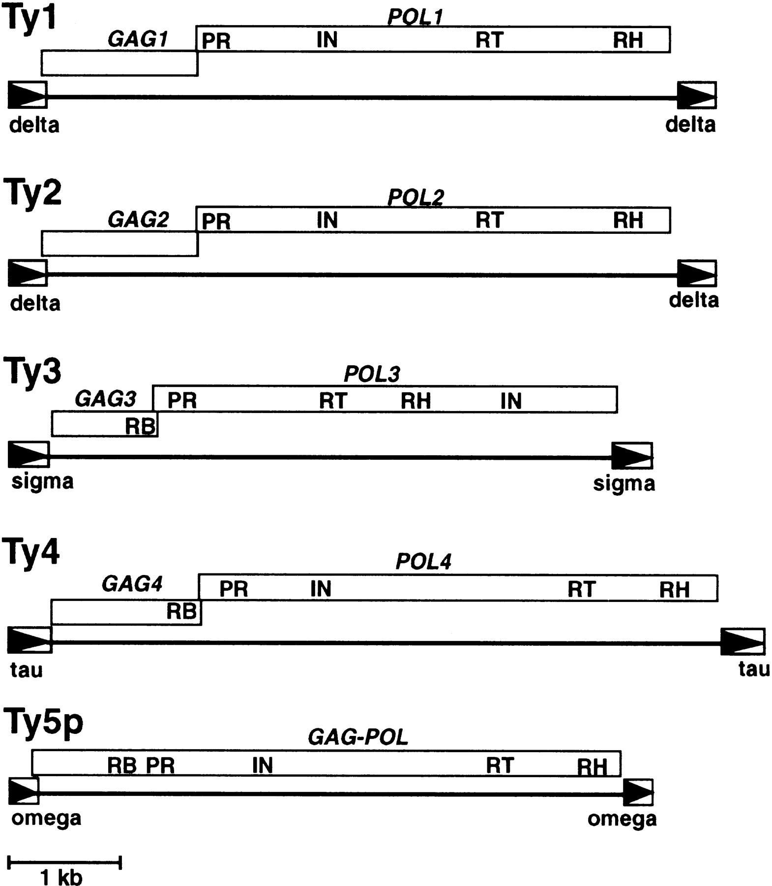
LTR retrotransposons are the only TE class in yeast
Ty1/Copia superfamily
Ty3/Gypsy superfamily
Kim, J.M., Vanguri, S., Boeke, J.D., Gabriel, A., & Voytas, D.F. (1998). Transposable elements and genome organization: a comprehensive survey of retrotransposons revealed by the complete Saccharomyces cerevisiae genome sequence. Genome research, 8 5, 464-78.
Notes:
5 families are identified originally in Scer, belonging to 2 superfamilies
the basic stucture of a LTR retrotransposon in yeast

Slide 5
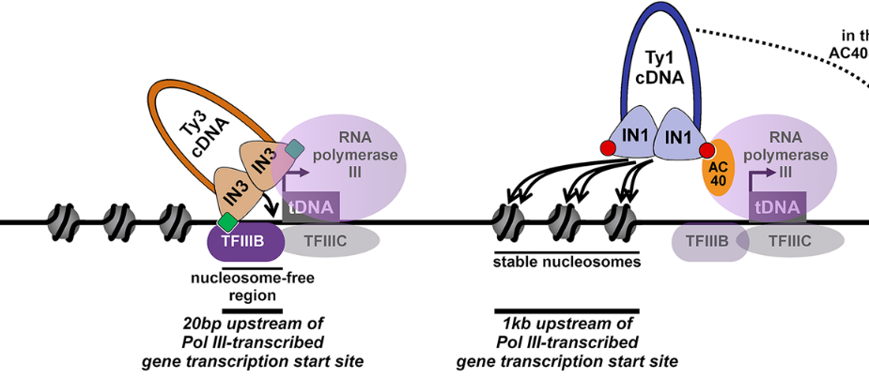
Ty1 and Ty3 target upstream of Pol III-transcribed genes (tDNA)
Bonnet et al. Curr Genet 67, 347–357 (2021).
Notes:
TE are not randomly inserted across the yeast genome
go back to this point later in my result chapter 1

Slide 6
Computational approaches to study TE abundance in genome sequences
Query-based TE annotation from whole genome assemblies (WGAs)
Polymorphic non-reference TE detection tools with un-assembled reads
Coverage-based TE abundance estimation with un-assembled reads
Notes:
to understand variations of TEs, methods are important
the repetitive feature of TE makes it chanllenging to detect TEs from the genome

Slide 7
Query-based TE annotation from WGAs
RepeatMasker: Identify and mask TE sequences from the genome assembly with Repbase or TE query library.
Post-processing of RepeatMasker output:
Using automated pipelines like REannotate.
Using custom scripts to clean up false-positives, rearrange annotated elements.
The most comprehensive TE detection approach.
Generates TE sequences, TE copy number, and genomic locations.
Limited by the quality of genome assemblies in repetitive regions.
Notes:
de novo genome assemblies with both short-read and long-read data could be challening for repetitive regions causing a lot of gaps
long-read data is limited

Slide 8
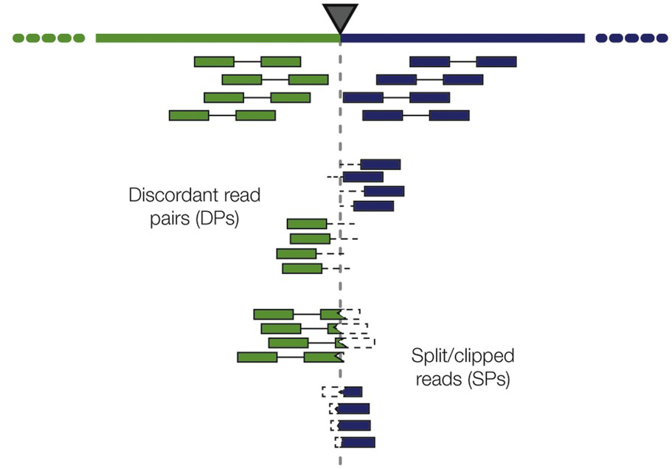
Polymorphic non-reference TE detection tools with un-assembled reads
Non-reference TE detection
Read pairs (RP)
Split reads (SR)
Rishishwar et al. Briefings in Bioinformatics 18, 908–918 (2017).
Large amount of bioinformatics tools have been developed for assembly-free reference-based TE detection using short-read WGS data.
Notes:
most applied on short-read sequencing data
DP where one read maps uniquely and one read maps to a repetitive TE sequence and (3) SR where part of one read maps uniquely and the other part maps to a repetitive TE sequence. The presence of DPs and SRs, along with the mapping distance between their paired reads, is used in the prediction of polyTE insertion sites.

Slide 9
Limitations for short-read TE detectors
Less sensitive than WGA TE annotation.
Usually not capable of generating sequences for complete elements.
Tools vary in their dependencies, run interfaces, and output formats.
Integrated meta-pipeline can be helpful for easy installation & execution, consistent output management, systematic error handling of different tools.
Performance of each tool may vary in different organisms.
Systematic evaluations are needed to select the best TE detector for different organisms.
Notes:
Motivates result chapter 1

Slide 10
Coverage-based TE abundance estimation with un-assembled reads
Notes:
Implemented in result chapter 1, applied in result chapter 3
rapid method to detect the presence/absence from a large-scale dataset
Quality of coverage-based strategy is depending on query library and mapping parameters

Slide 11
Computational approaches to study TE abundance in genome sequences
Query-based TE annotation from whole genome assemblies (WGAs)
Polymorphic non-reference TE detection tools with un-assembled reads
Coverage-based TE abundance estimation with un-assembled reads
Result chapter 2/3
Result chapter 1
Result chapter 1/3

Slide 12
Outline of thesis
Result chapter 1: Reproducible evaluation of transposable element detectors with McClintock 2 guides accurate inference of Ty insertion patterns in yeast.
Result chapter 2: High-quality genome assemblies of S. paradoxus and S. uvarum.
Result chapter 3: Evolution of the Ty4 retrotransposon family in Saccharomyces yeasts driven by horizontal TE transfer and recombination.
Notes:
outline of thesis

Slide 13
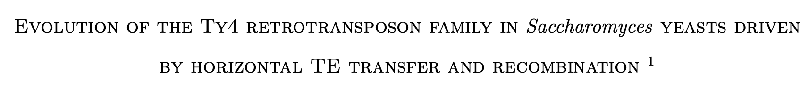
Results chapter 3
Notes:
resolve evolutionary history of Ty4 family in Sac yeast

Slide 14
The Saccharomyces genus
Baker’s yeast frequently used in winemaking, brewing and baking industry.
Well-studied model species in molecular and evolutionary biology.
Notes:
the sac is a genus of unicellular eukaryotic organisms
up to now the species Ive discussed is the model species
spar is well studied as a wild relative
the sister species on the basal branch, suva and seub, has also been well studies previously

Slide 15
LTR retrotransposons are the only TE class in yeast
Ty1/Copia superfamily
Ty3/Gypsy superfamily
Kim, J.M., Vanguri, S., Boeke, J.D., Gabriel, A., & Voytas, D.F. (1998). Transposable elements and genome organization: a comprehensive survey of retrotransposons revealed by the complete Saccharomyces cerevisiae genome sequence. Genome research, 8 5, 464-78.

Slide 16
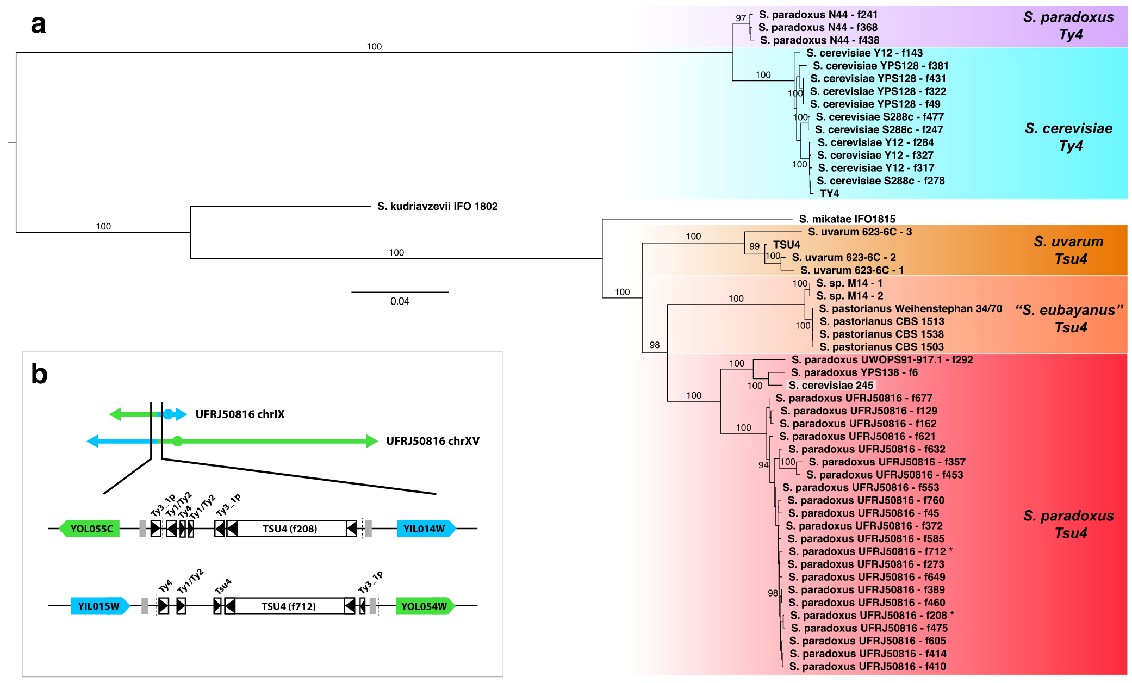
Ty4 and Tsu4 subfamilies are found in different yeast species and involved in horizontal TE transfer (HTT) events
Ty4 subfamily?
Stucka et al. (1989)
Ty4 family
Tsu4
Tsu4 subfamily?
Unexpected Tsu4 subtype in:
S. paradoxus (HTT reported)
S. cerevisiae?
S. mikatae?
?
Neuveglise et al. (2002)
?
What are the ancestral states/global distribution of Ty4/Tsu4 subfamilies?
What is the evolutionary history of the Ty4 family in yeast?
Bergman. Mobile DNA 9, (2018).
Notes:
Ty4 family consists of two subfamilies: Ty4 identified in Scer. Tsu4 Suva
Limited number of sample

Slide 17
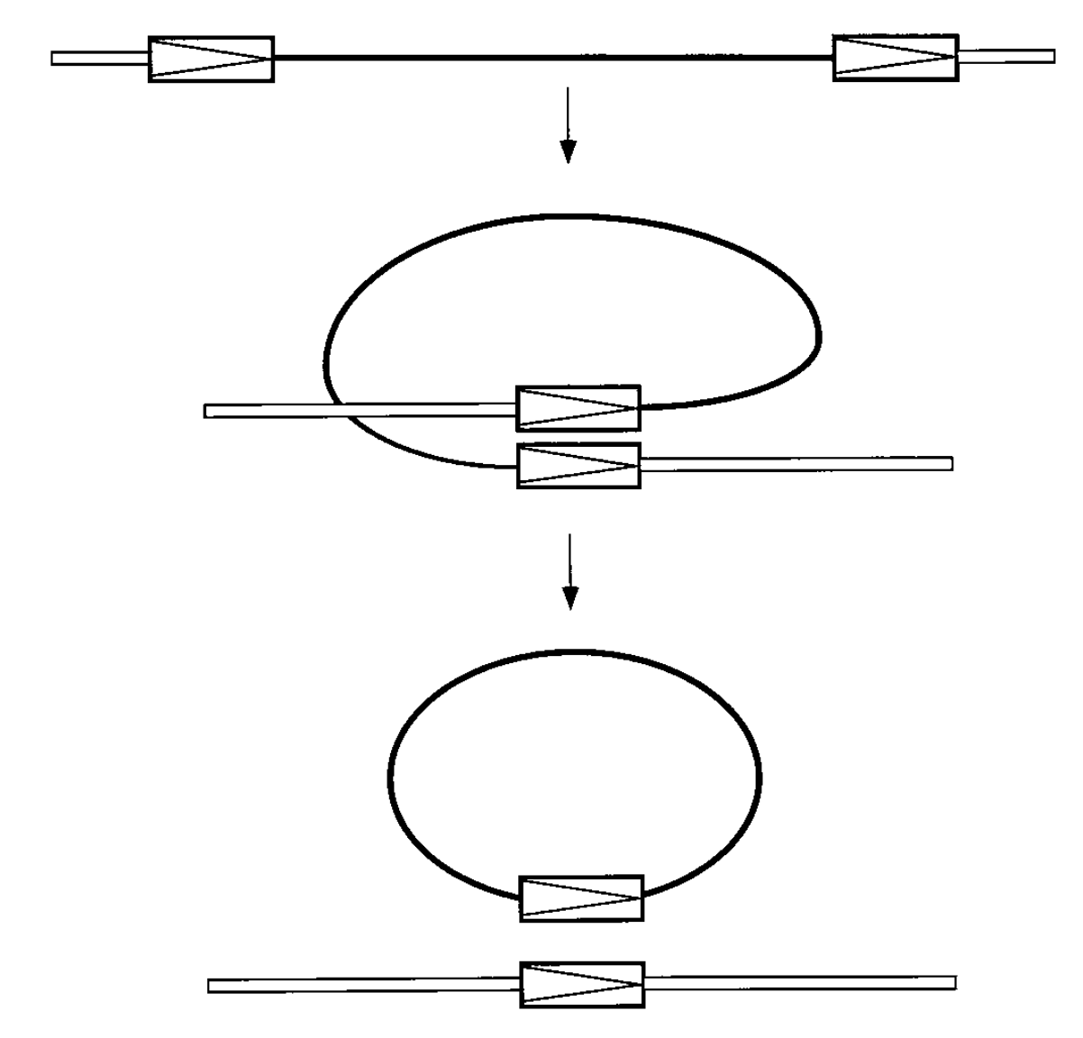
LTR-LTR recombination creates solo LTRs
LTR
Internal
LTR
Full length LTR retrotransposon
(evidence of recent activity)
LTR-LTR recombination
A single LTR + the internal coding sequence
Solo LTR (evidence of past activity)
Jordan IK, McDonald JF. Tempo and mode of Ty element evolution in Saccharomyces cerevisiae. Genetics. 1999;151(4):1341-51.
Notes:
Recombination very fast

Slide 18
What are the ancestral states/global distribution of Ty4/Tsu4 subfamilies?
Ty4/Tsu4 content scan using McClintock 2 coverage module
Species | # Sample | # Studies
S. cerevisiae | 2,404 | 27
S. paradoxus | 371 | 9
S. uvarum | 62 | 4
S. eubayanus | 292 | 11
S. mikatae | 18 | 1
Notes:
I comprehensively investigate the ty4/tsu4 content in 5 sac species integrating public WGS datasets
I'll go through the results of these five species one by one

Slide 19
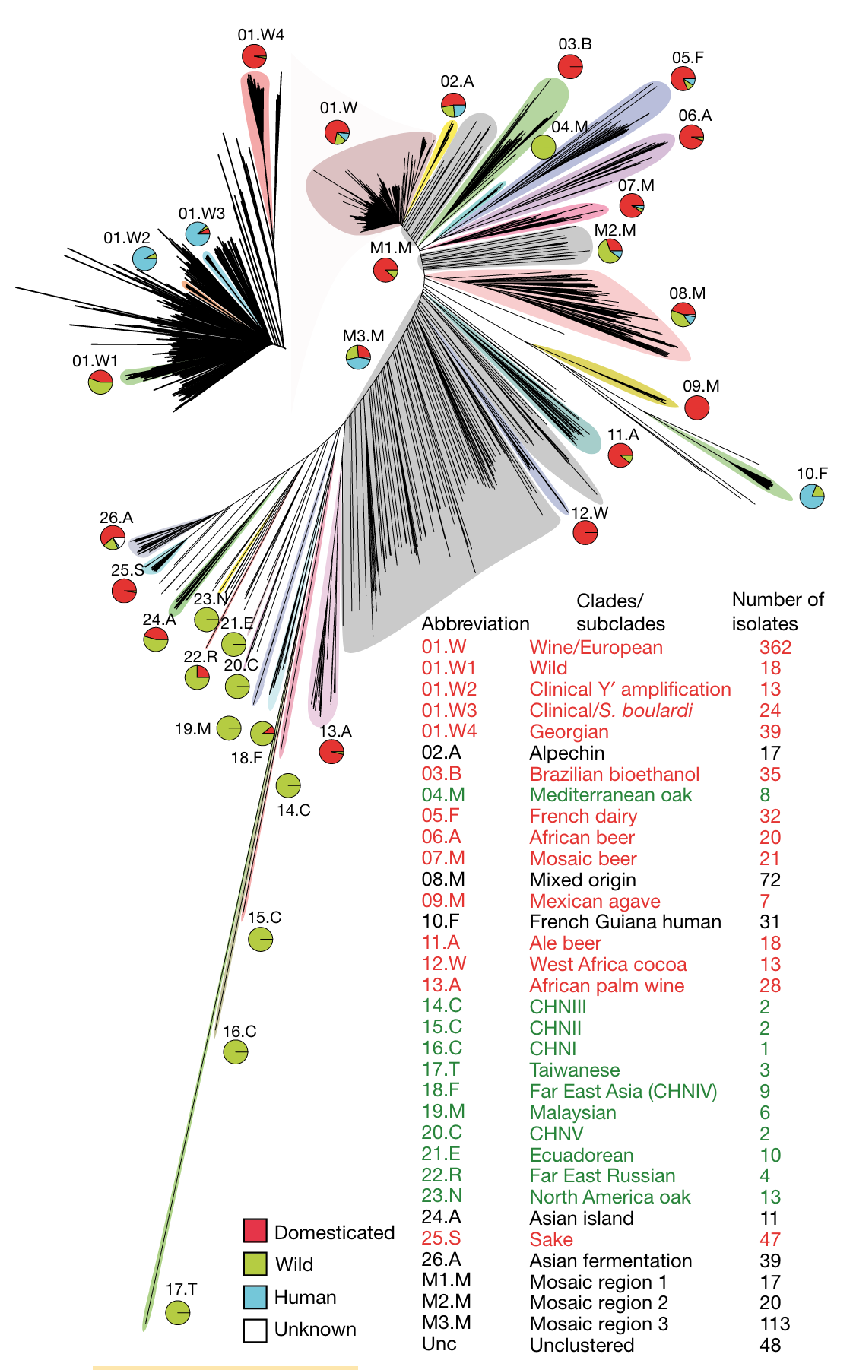
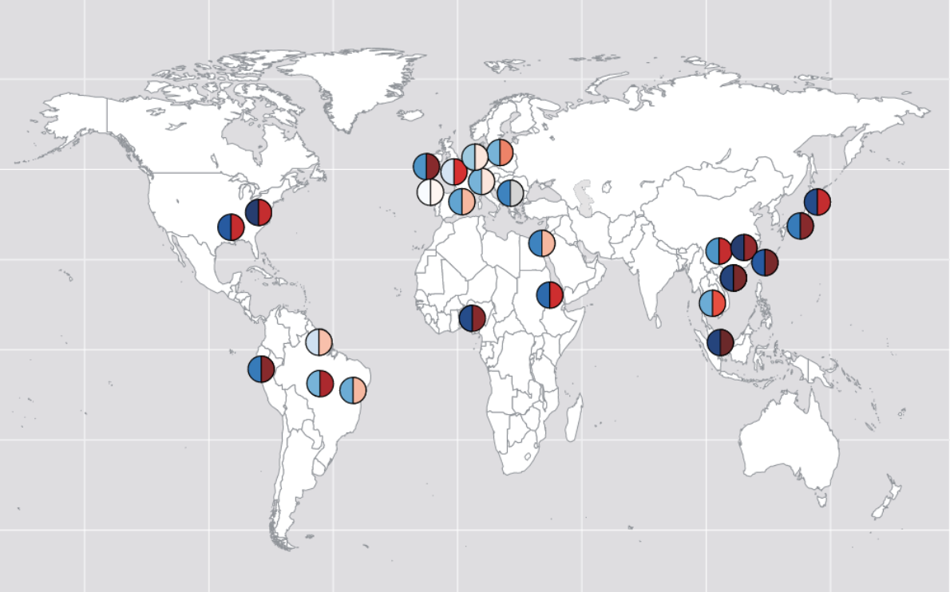
Population structure of S. cerevisiae
1000+ isolates
Peter et al. Nature 556, 339 (2018).
Notes:
best-studied species
distributed globally

Slide 20
Ty4 subfamily is ancestral for S. cerevisiae
Ty4 subfamily is found in all S. cer lineages.
2,400+ isolates integrated across 20+ studies

Slide 21
Tsu4 subfamily is geographically restricted in S. cerevisiae
Tsu4 subfamily is only found in few lineages from Central/South American region.
HTT introduced Tsu4 subfamily into S. cer
Notes:
HTT could be very recent, because not yet spread to other lineages

Slide 22
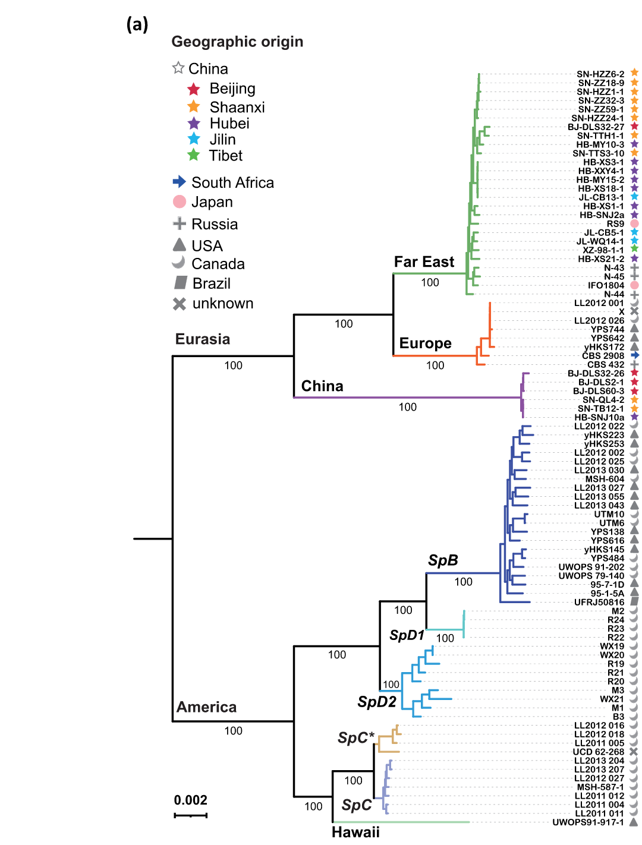
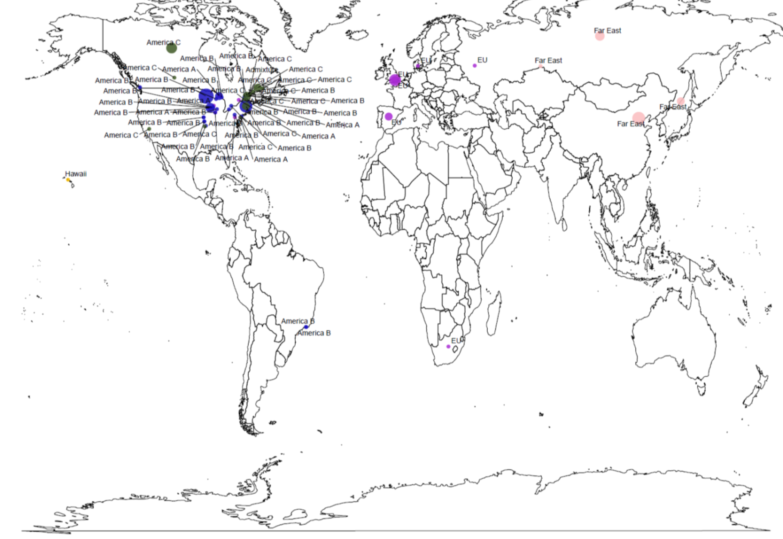
Population structure of S. paradoxus
North America
Europe (EU)
Far East (FE)
Hawaii
South America (SA)
Peris et al. Nat Commun 14, 690 (2023).
Major distinct lineages: Eurasia and America.
Hawaii strains is an outgroup of SpC and SpC*.
The South American strain is a member of SpB.
He et al. Yeast 39, 69–82 (2022).
Notes:
majority of Spar are sampled from NA

Slide 23
Ty4 subfamily is ancestral for S. paradoxus
Ty4 subfamily is found in all S. par strains.
Internal sequences are found in Far East population.
Tsu4 subfamily is found in all American strains.
HTT introduced Tsu4 into S. par.
Notes:
Tsu4 subfamily derived from a HTT event into Spar

Slide 24
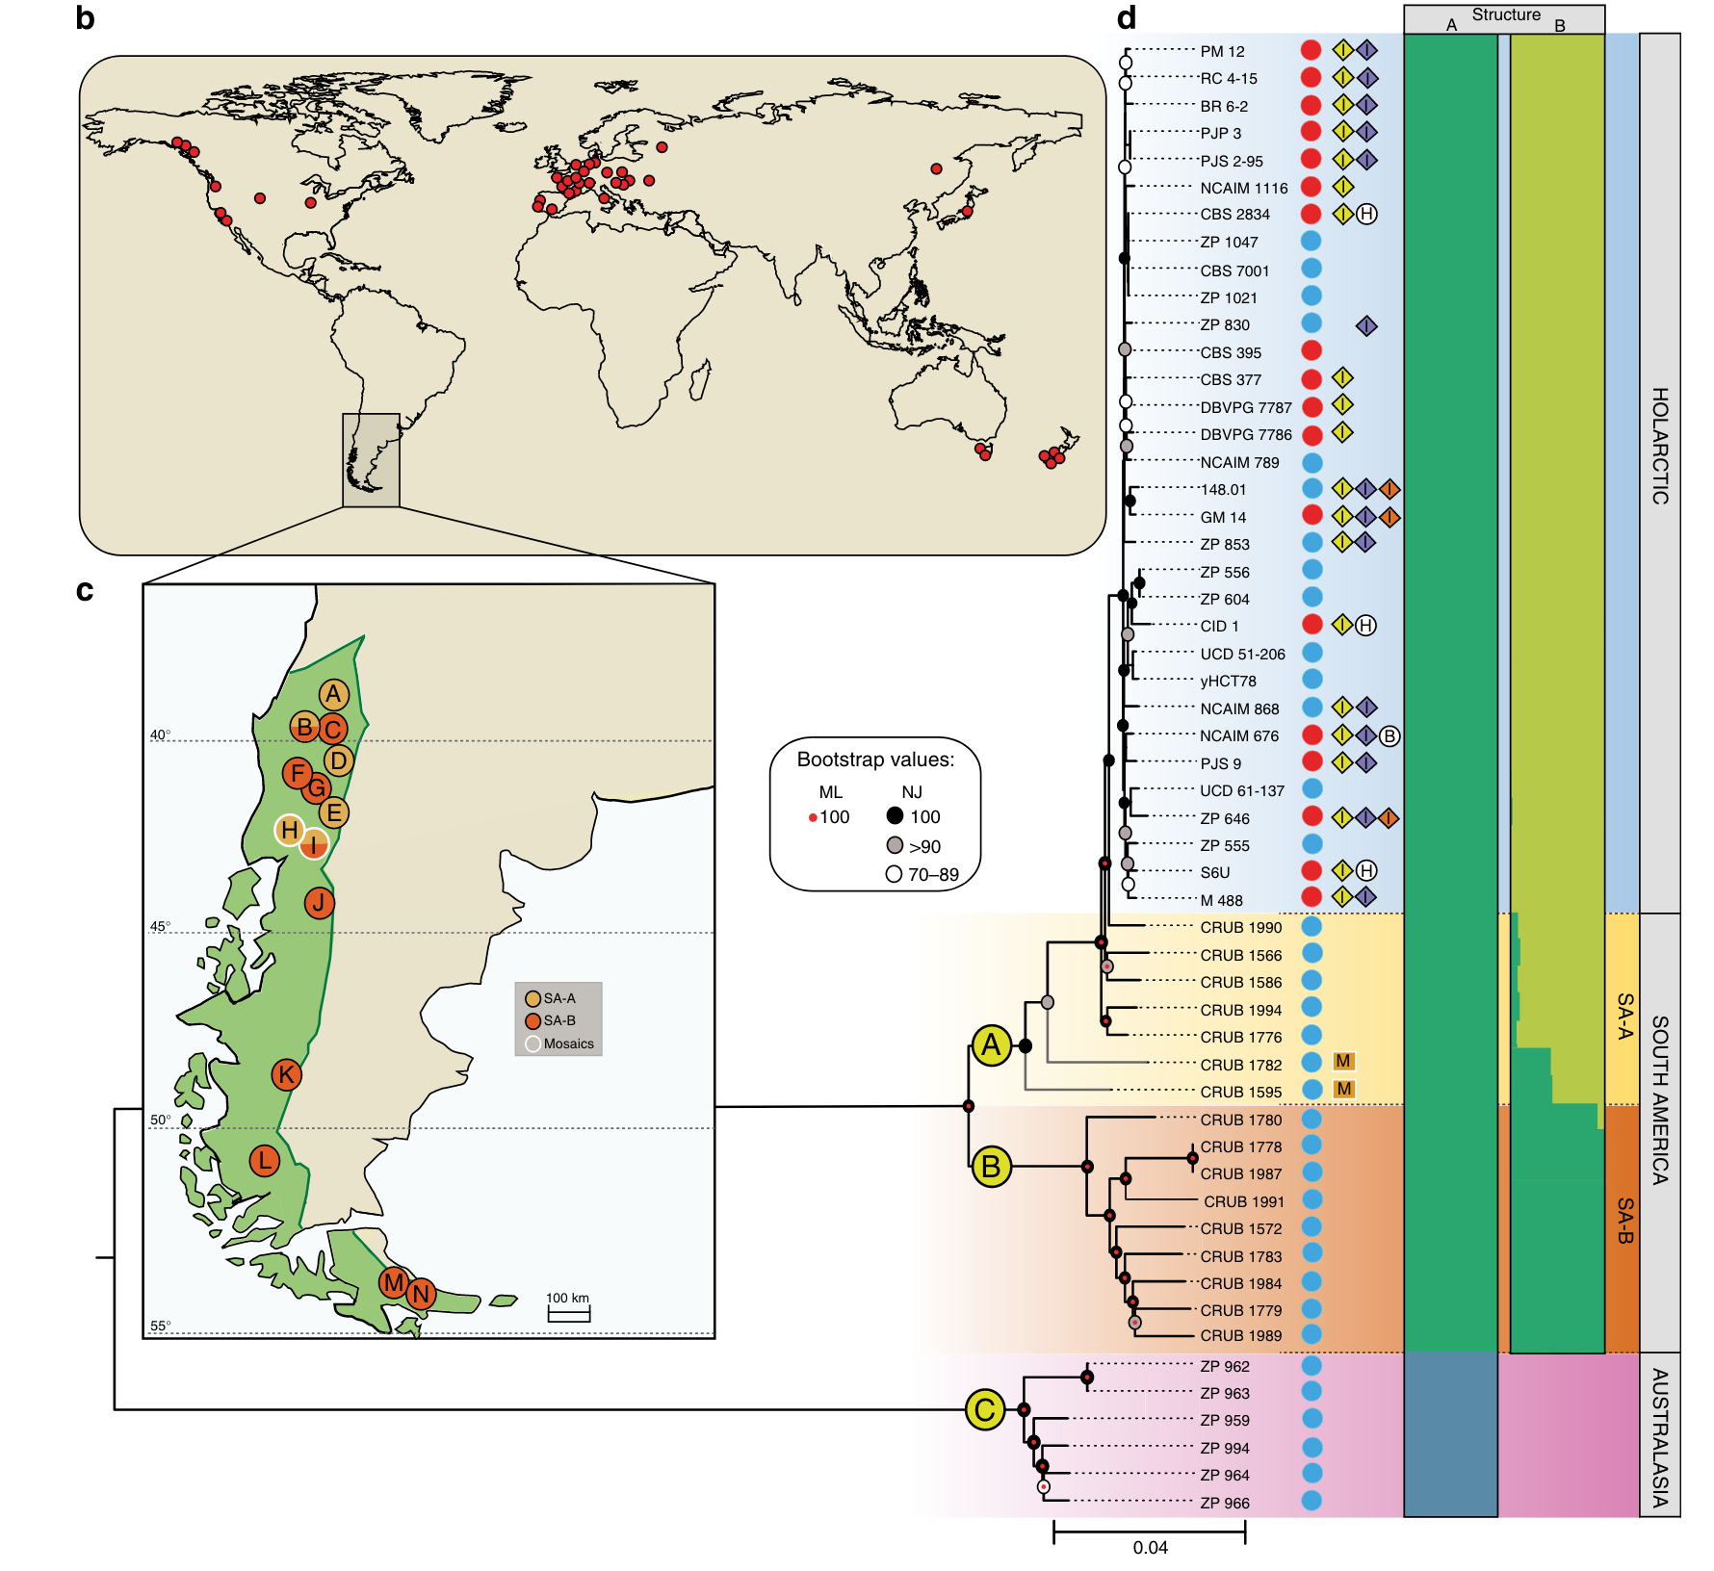
Population structure of S. uvarum
Divergent in Australasia.
Two separate South America lineages.
Holarctic (North America, Europe, Far East) is a sub-lineage of SA-A.
Almeida et al. Nature Communications 5, (2014).
Notes:
Divergent in Australasia.
Two separate South America lineages.
Holarctic (North America, Europe, Far East) is a sub-lineage of SA-A.

Slide 25
Tsu4 subfamily is ancestral for S. uvarum
Ty4 subfamily is absent in all S. uva strains.
Tsu4 subfamily is the ancestral state.

Slide 26
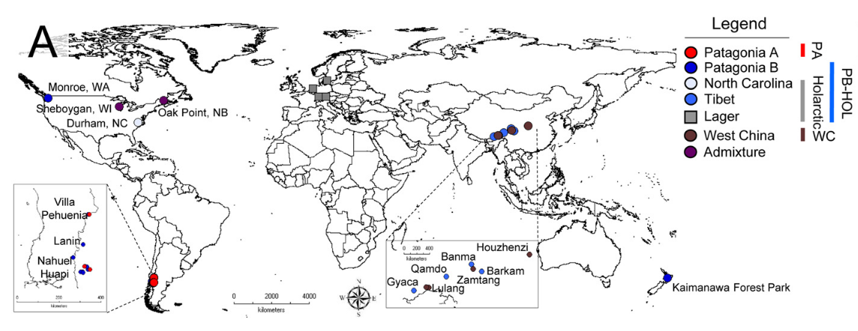
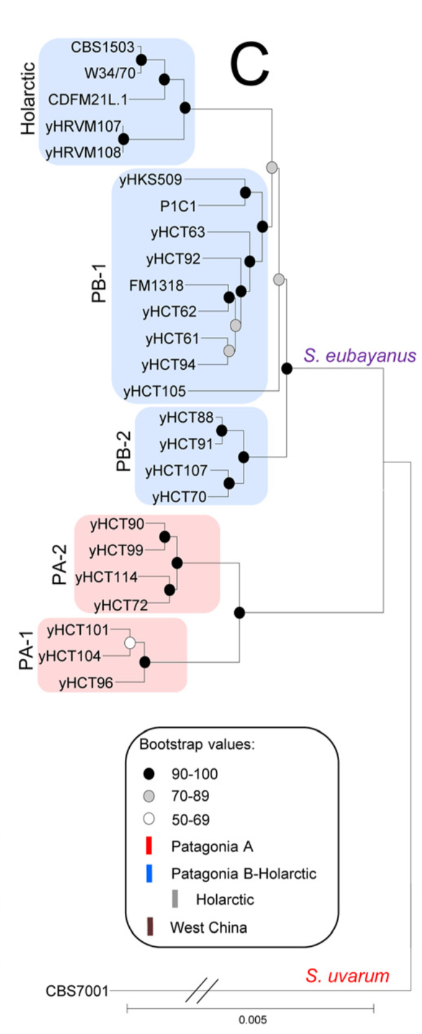
Population structure of S. eubayanus
Holarctic
PB
PA
Extensively sampled from Patagonia region, forming PA and PB.
Holarctic (North America and Tibet) is a sub-lineage of PB.
Peris et al. PLOS Genetics 12, e1006155 (2016).
Notes:
Population structure of hol seub is important

Slide 27
Tsu4 subfamily is ancestral for S. eubayanus
Ty4 subfamily is essentially absent in all S. eub strains.
Tsu4 subfamily is the ancestral state.

Slide 28
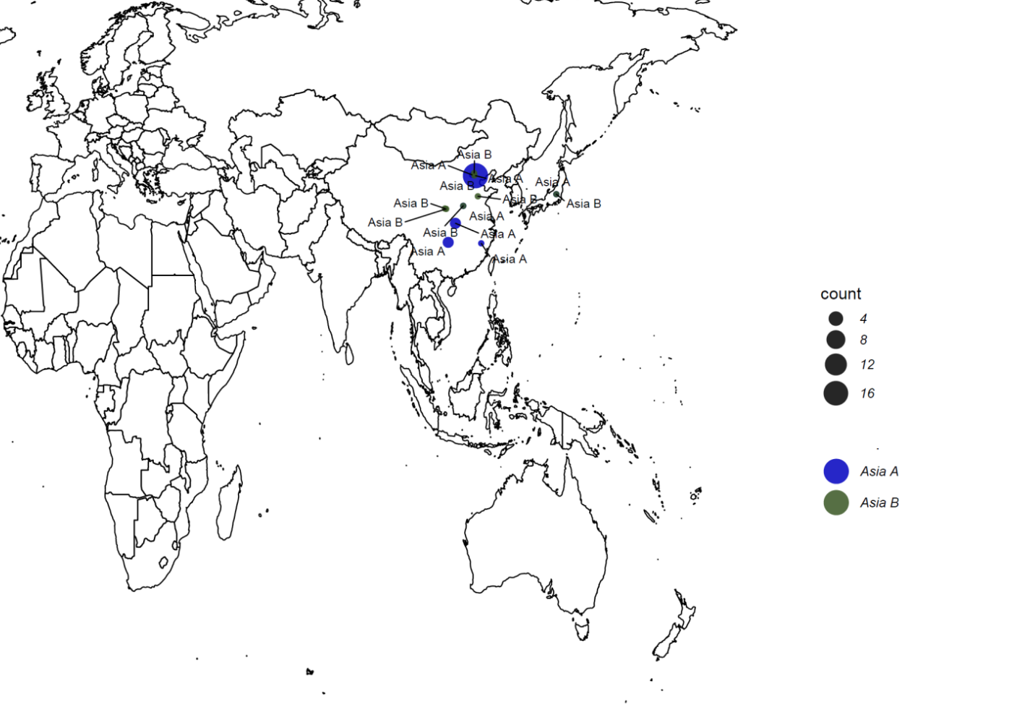
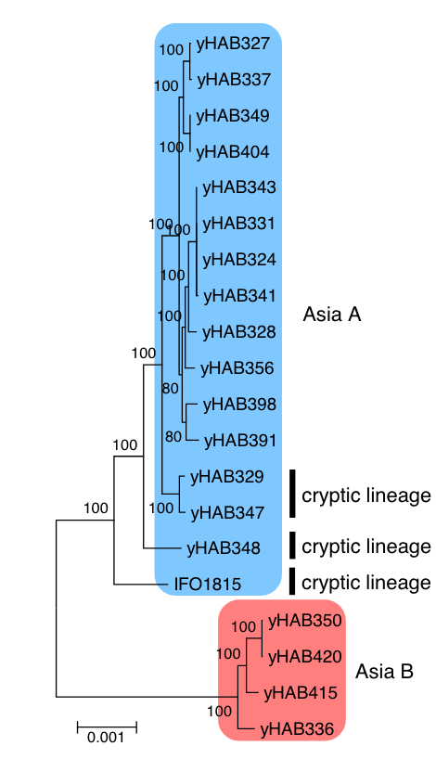
Population structure of S. mikatae
General sampling is limited only in Asia.
Peris, D. et al. Macroevolutionary diversity of traits and genomes in the model yeast genus Saccharomyces. Nat Commun 14, 690 (2023).

Slide 29
Ty4 and Tsu4 subfamilies are both found in S. mikatae
Both subfamilies are present.
Tsu4 subfamily is active.
Strain | Population | TY4_full | TY4_truncated | TY4_solo | TSU4_full | TSU4_truncated | TSU4_solo
NCYC3947 | EU | 0 | 0 | 7 | 4 | 2 | 137
NCYC3962 | EU | 0 | 0 | 6 | 3 | 2 | 138
S. jurei

Slide 30
Overview of Ty4/Tsu4 ancestral states across Saccharomyces species
Ty4 subfamily
HTT after speciation
Ty4 subfamily?
HTT after speciation
HTT in common ancestor?
+ + + +
- - + -
Tsu4 subfamily

Slide 31
What is the evolutionary history of the Ty4 family in yeast?
Ty4/Tsu4 annotation from WGAs
Species | # Assemblies | # Studies
S. cerevisiae | 210 | 8
S. paradoxus | 12 | 3
S. uvarum | 1 | 1
S. eubayanus | 4 | 3
S. mikatae | 2 | This study
S. jurei | 2 | 1
RepeatMasker-based TE annotation
Phylogenetic analysis for full-length elements

Slide 32
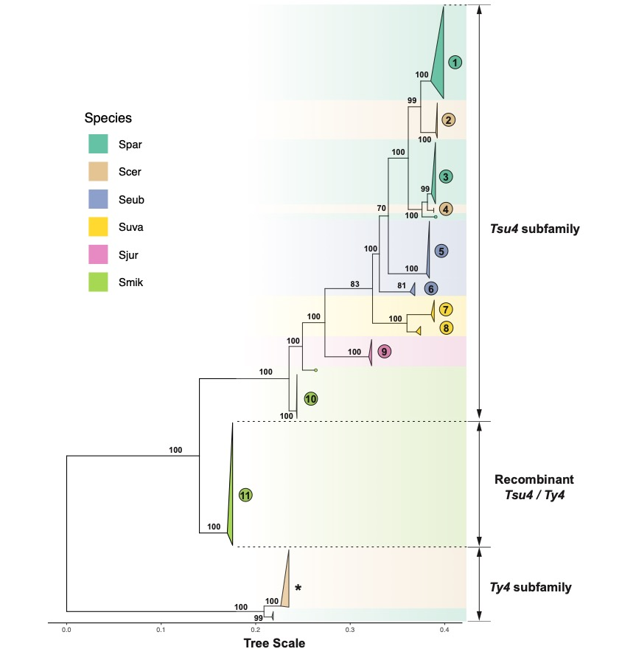
Phylogenetic analysis of Ty4/Tsu4 sequences in Saccharomyces species
Full-length elements of the Ty4 subfamily are only found in S. cer/S. par.
Full-length Tsu4 elements are found in all yeast species.
Tsu4 elements show evidence of HTT and recombination.
Notes:
ml tree for all full-length Ty4/Tsu4 elements
3 major clades
Next, I'll zoom-in to each clades of Tsu4 sequences by pairs of sister species

Slide 33

S. cerevisiae and S. paradoxus
Two clades of Tsu4 sequences in S. cer.
Two HTT events from S. par to S. cer.
Co-existence of Ty4/Tsu4 full-length elements in CQS.
Two clades of Tsu4 sequences in S. par with incongruence between host and TE phylogeny.
Two HTTs of Tsu4 into S. par, one in North America and one in South America?
Incomplete lineage sorting?
Notes:
Invasion happen multiple times
Mention CQS coexitence

Slide 34
S. uvarum and S. eubayanus
Two groups of Tsu4 in S. eub with incongruence between host and TE phylogeny.
HTT of a distinct Tsu4 sequence into Holarctic S. eub?
Incomplete lineage sorting?
Holarctic S. eub is the closest group to S. par/S. cer Tsu4.
Tsu4 sequences in S. uva form a monophyletic group.

Slide 35
S. mikatae and S. jurei
Tsu4 sequences in S. jur form a monophyletic group, closest to S. uva/S. eub Tsu4.
Two distinct groups of Tsu4 are found in S. mik.
Difference between “Recombinant” and “Pure” Tsu4 groups in S. mik?

Slide 36
Sequence divergence reveals recombinant Ty4/Tsu4 subfamily in S. mikatae
First 1/3 part of “recombinant” Ty4/Tsu4 shows more sequences similarity to Ty4 rather than Tsu4.
Notes:
X and y axis
bars down below each panel are annotations for a full elemensts

Slide 37
ML phylogeny for 5' and 3' internal regions from Tsu4 full-length elements
Recombinant Tsu4/Ty4 elements in S. mik reveal the HTT of Tsu4 subfamily into S. mik, followed by the co-existence and recombination of two subfamilies.

Slide 38
Summary for Chapter 3
Resolved ancestral states of Ty4/Tsu4 subfamilies among several Saccharomyces yeasts:
S. cer & S. par: Ancestral state is Ty4 subfamily. Tsu4 is found in restricted lineages.
S. uva & S. eub: Ancestral state is Tsu4 subfamily.
S. mik & S. jur: Both Ty4 and Tsu4 subfamilies are present.
Identified multiple HTT events involving Ty4/Tsu4 subfamilies in yeast:
Two HTTs that introduced Tsu4 subfamily into N. American and S. American S. par.
Two HTTs that introduced Tsu4 from S. par into Central/South American S. cer.
One HTT that introduced divergent Tsu4 sequence into Holarctic S. eub.
HTT that introduced Tsu4 into the common ancestor of S. mik/S. jur.
Found co-existence and recombination of Ty4 and Tsu4 subfamilies in S. mik.

Slide 39
Conclusions
The reimplementation of McClintock 2 facilitated installation, execution, and evaluation of short-read TE detectors.
The reproducible simulation system identified best-in-class component methods, which revealed new insights into yeast TE insertion preferences.
TE content scan from WGS data resolved ancestral states of subfamilies in the Ty4 family among Saccharomyces yeasts.
Phylogenetic analysis of TE sequences annotated from WGAs revealed the important role of HTT and recombination events in shaping TE content in Saccharomyces yeasts.

Slide 40
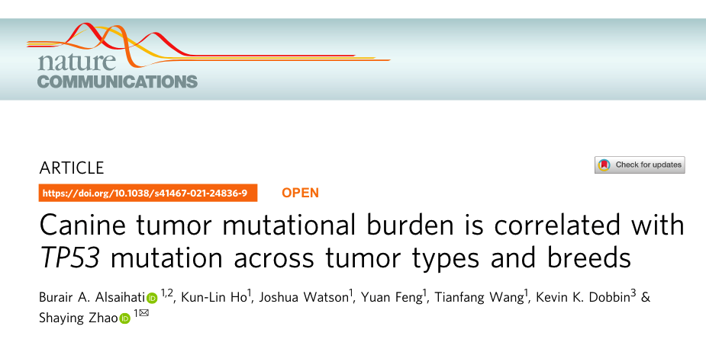
Move on to the next journey…

Slide 41
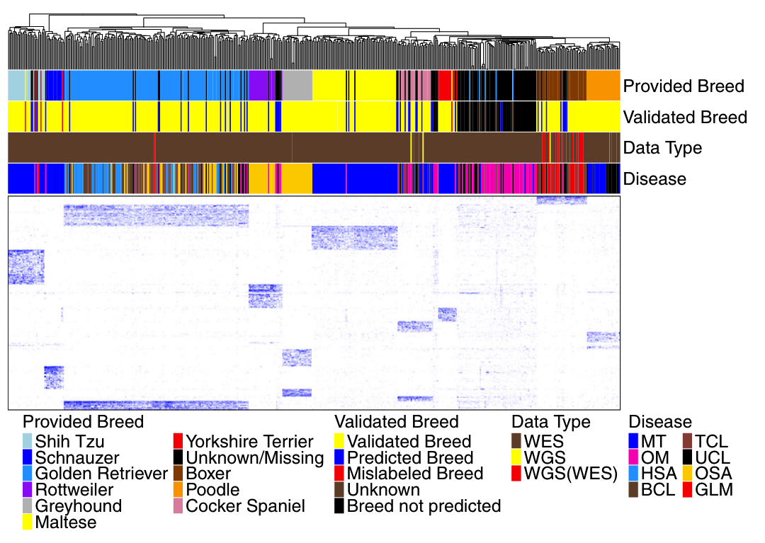

Slide 42
Data Collection
Canine read mapping
Read harmonization
Germline variant calling
Somatic mutation calling
Breed prediction & validation
Validation and other analysis

Slide 43
Short-term plan
Collect newly published canine WES datasets on NCBI (data since 2020).
Test the developed pipeline, make sure it’s working on cluster.
Use Snakemake to manage the workflow.
Repeat the pipeline (for breed prediction) on 10 cases. Compare with previous runs for validation.
Repeat the breed prediction/validation analysis using backup results.

Slide 44
Data Collection
Inspected 22 dog WES BioProjects on NCBI since July 2019.
New dataset: 374 dogs (Tumor-Normal pairs).
Canine read mapping
Read harmonization
Germline variant calling
Somatic mutation calling
Breed prediction & validation
Validation and other analysis

Slide 45
Data Collection
Canine read mapping
Tested
Read harmonization
Germline variant calling
Somatic mutation calling
Breed prediction & validation
Validation and other analysis

